Slide 1
Kubernetes Cluster Deployment using Kops

Slide 2
Content
Kubernetes Introduction
Kops Introduction
Steps to Deploy a Kubernetes Cluster using Kops

Slide 3
What is Kubernetes
Kubernetes is an open-source system for automating deployment, scaling, and management of containerized applications.
Google open-sourced the Kubernetes project in 2014. Kubernetes builds upon a decade and a half of experience that Google has with running production workloads at scale, combined with best-of-breed ideas and practices from the community.

Slide 4
Kubernetes Features
Load balancing
Rolling update or rollback
Resource monitoring and logging
Container grouping using pod
Self-healing
Auto-scalablility
DNS management
·

Slide 5
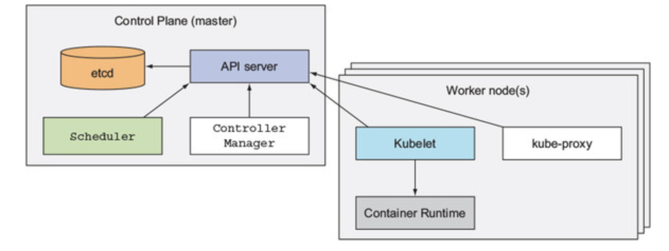
Kubernetes Cluster Components

Slide 6
What is Kops
Kops (short for Kubernetes Operations) is the easiest way to get a production grade Kubernetes cluster up and running.
Kops helps you create, destroy, upgrade and maintain production-grade, highly available, Kubernetes clusters from the command line. AWS (Amazon Web Services) is currently officially supported, with GCE in beta support , and VMware vSphere in alpha, and other platforms planned.

Slide 7
Kops Feature
Supports custom Kubernetes add-ons
Command line autocompletion
YAML Manifest Based API Configuration
Templating and dry-run modes for creating Manifests
Choose from eight different CNI Networking providers out-of-the-box
Supports upgrading from kube-up
Capability to add containers, as hooks, and files to nodes via a cluster manifest
Automates the provisioning of Kubernetes clusters in AWS
Deploys Highly Available (HA) Kubernetes Masters
Built on a state-sync model for dry-runs and automatic idempotency
Ability to generate Terraform

Slide 8
Steps to Deploy a Kubernetes Cluster
Install Kops, kubectl, AWS CLI
Setup IAM user
Configure DNS
Create Cluster State storage
Create cluster configuration
Customize Cluster Configuration
Build the Cluster

Slide 9
Thank you.

